Slide 1



Slide 2

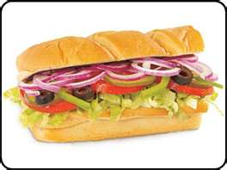

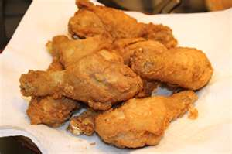
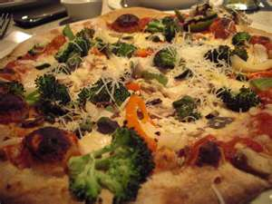
Best Choices for Fast-Food
Subway / Quiznos / Deli
Panera Bread
Chipotle
Second-Best
Mc.Donald’s / BK / Wendy’s
Pizza
Worst Choices
KFC
Taco Bell
Fish-Fry / Long John Silver’s

Slide 3
IMPORTANT!
It is up to YOU to choose the right items!!
Just because a restaurant is in the “Best Choice” category doesn’t mean everything there is healthy!
You still need to choose wisely.
You generally know what is healthy and what is not.
Trust yourself and use the tips provided to help you make better decisions at mealtime.

Slide 4

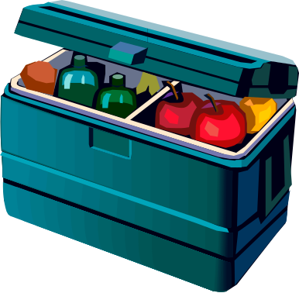
Eat breakfast at home &
Invest in a cooler.
Easy things to pack:
-Sandwiches
-Salads
-Fruit
-Cut-up veggies
-Snack bars
-Nut and seed trail mixes.
-Whole grain crackers
-String cheese
-Yogurt
-Cereal and milk

Slide 5

Front-load w/protein
Beware of the booze
Portion distortion
Enjoy the conversation
Avoid freebies
Don’t fall for combos
Drink responsibly
Think big
Think thin
Invite the kids to the grown-up table
Side with sides
Personalize your order
Order to go
Dodge dessert

Slide 6

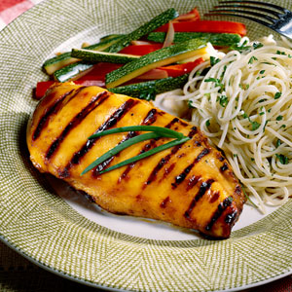
Select foods that are:
  Steamed in their own juice (au jus)
  Broiled
  Baked
  Roasted
  Poached
  Lightly sauteed
  * If you see something on the menu you really want, but it is fried, you can always ask for grilled. The restaurant is there to serve YOU!

